Slide 1

Front Cover

Slide 2


Pages 1 - 2

Slide 3

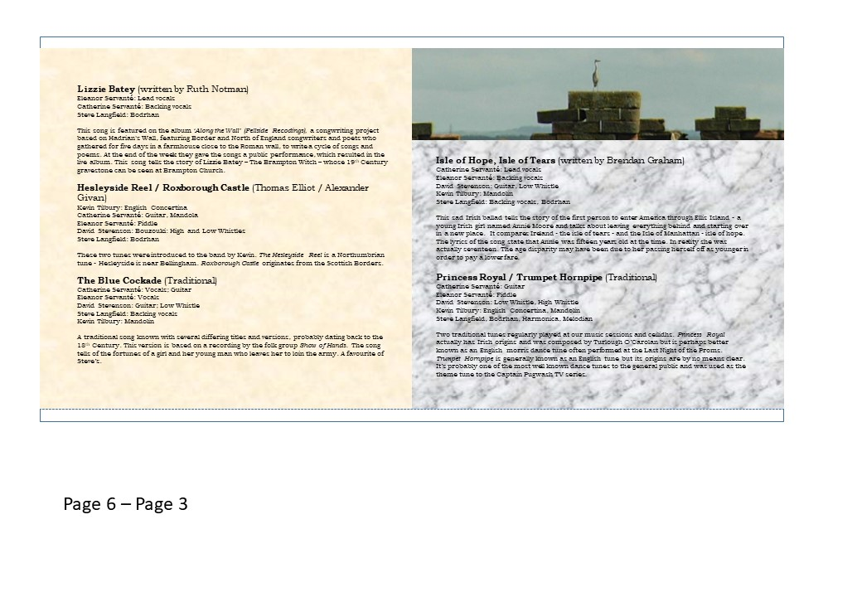
Pages 3 - 4

Slide 4

Pages 5 - 6

Slide 5
Pages 7 - 8

Slide 6

Pages 9 - 10

Slide 7

Back cover
Rear insert

